Slide 1
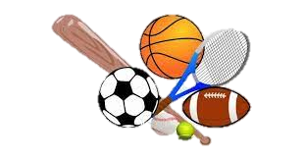
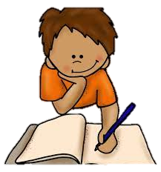


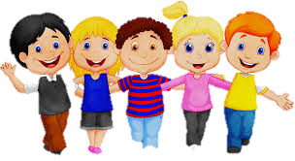
All About Me
Year 7 Health
Lesson 3
2024

Slide 2

GLOSSARY: (Pg. 5)
At the front of your books is your glossary. Turn to your glossary and add the following words and their definitions:
Health:
    Health is a state of complete physical, mental, and social well-being and not merely the absence of disease or infirmity.
Well-being:
    A state of being healthy, happy, and comfortable, both physically and mentally. It encompasses being content and satisfied with your life and experiences.
Notes:
Health definition:
https://www.who.int/about/governance/constitution
Well-being definition:
https://www.wellbeingpeople.com/what-is-wellbeing/#:~:text=Wellbeing%20refers%20to%20a%20state,your%20personal%20and%20professional%20experiences.

Slide 3

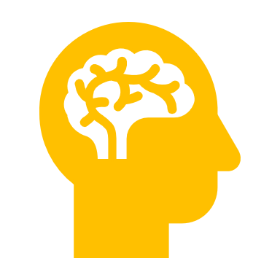
“A person who never made a mistake, never tried anything new.”
(Albert Einstein)
hook: (Pg. 11)
Resilience – What is it?
As a class you need to get yourselves in height order.
You must do this WITHOUT talking.
Once in order, turn to the person next to you and chat
about two questions.
You have 2 minutes.
Be prepared to share your responses.
TALLEST SHORTEST
Q1: What is resilience?
Q2: Why is resilience important in maintaining our mental and emotional wellbeing?
Notes:
Assessment 2 related
pg11

Slide 4
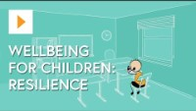
Activity 1: Resilience – What is it? (Pg. 11)
You’ve just had a chat with a classmate about resilience and why it is important.
While watching the video, jot down any additional answers to those two questions.
What is resilience?
Why is resilience important in maintaining our mental and emotional wellbeing?
Be prepared to share your responses.
Notes:
https://www.youtube.com/watch?v=zeu9X88g8DE

Slide 5
THINK, pair, Share (Pg. 11)
You will have 1 minute to THINK about your response to a question.
You will then have 1 minute 30 sec to PAIR with the person next to you and discuss your thoughts.
Finally, be prepared to SHARE your thoughts with the class.
PHYSICAL HEALTH
SOCIAL HEALTH
EMOTIONAL HEALTH
MENTAL HEALTH
SPIRITUAL HEALTH
”Our life can be considered across different dimensions.
One dimension of our health is our physical health.
There are 5 dimensions.
What are the other 4 dimensions?”
We are going to look at how resilience can impact our mental and emotional health and well-being.

Slide 6
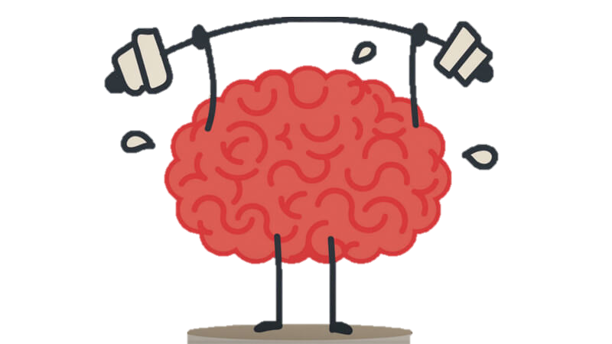
ACTIVITY 2:
Mental Well-being (Pg. 12).
Mental well-being refers to a state of positive mental health characterized by a person's ability to cope with the normal stresses of life, work productively, and make meaningful contributions to their community.
It involves having:
    A positive sense of self
    Maintaining healthy relationships
    Being able to effectively manage emotions, thoughts, and behaviours.
Notes:
Assessment 2 related
Fill in the blanks

Slide 7
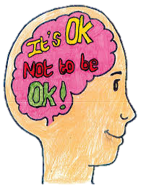
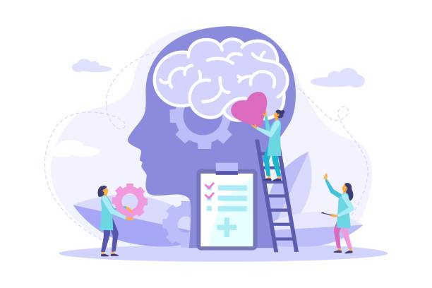
Emotional Well-being: (Pg. 12).
Emotional well-being pertains to the ability to understand, express, and manage emotions in a healthy and balanced way.
It involves:
    Being aware of and accepting one's emotions
    Having the skills to regulate them
    Experiencing a sense of overall emotional satisfaction and stability.
Notes:
Assessment 2 related
Fill in the blanks

Slide 8


Activity 3:
Real Life Resilience (Pg. 12).
Write examples of when you have used resilience in your in your life.
SPIT FIRE – What factors could affect someone’s resilience in a positive way? **think about what helped you to be resilient**
    Positive Relationships
    Problem-Solving Skills
    Self-Care Practices
    Positive Self-Beliefs
    Emotional Regulation Skills
    Optimism and Positive Outlook
Notes:
SPIT FIRE = ask students to call out their responses.

Slide 9
GLOSSARY: (Pg. 5).
At the front of your books is your glossary.
Turn to your glossary and add your own definition for RESILIENCE.
Make sure your definition consists of at least two sentences.
Notes:
A comprehensive definition for resilience will be useful for their Assessment Task 2.

Slide 10

Assessment task 1: All about me
Reminder:
Assessment Task 1 – All About Me
Due next week

Slide 11

ADDITIONAL ACTIVITY
Assessment Task 1: All about me
The remainder of this lesson can be spent working on your assessment task.
Remember:
  Due: week 4
  Two whole weeks to complete at home.
  Create a poster all about yourself!
Notes:
Hand out Assessment Task 2
Teacher discretion – can be hard copy or electronic on Canva
Optional – lesson to work on assessment in class in time permits

Slide 12

Additional activity:
Resilience kahoot P.g. 1
Resilience: What do you know?
https://create.kahoot.it/share/duplicate-of-resilience/2cf4af06-ce82-4627-a62d-deab605fd954
Notes:
https://create.kahoot.it/share/duplicate-of-resilience/2cf4af06-ce82-4627-a62d-deab605fd954
Skip if you don’t perceive there to be enough time, or if you’d prefer to give more class time to work on their assignment.

